Slide 1
Case 2: CKD / HTN / AFib
Patient case: John is a 70 years old male, height 176 cm, weight 84 kg, BMI 26.5
Current problems: non-proteinuric chronic kidney disease (CKD) with severely decreased kidney function (eGFR of 35), significant anemia (hemoglobin level of 95), stable ferritin level of 110, no metabolic disturbances; hypertension (HTN)
Current medications:
erythropoiesis-stimulating agent (ESA), low-dose aspirin – to manage CKD
calcium channel blocker (CCB), diuretics – to manage HTN
ACE inhibitor (ACEI) – to manage both CKD and HTN
Current non-pharmacological treatment: lifestyle management to minimize the risk of cardiovascular disease (CVD) associated with CKD and to control HTN
New problem: atrial fibrillation (AFib)
Management scenario: For last year John experienced multiple episodes of irregular heartbeat that resolved on its own. However, for last 2 days John is experiencing pronounced irregular heartbeat with the increasing intensity of the associated symptoms of breathlessness, dizziness, and chest discomfort. Upon admission to the ED, John is diagnosed with tachycardia and persistent, highly symptomatic acute, non-valvular AFib that is confirmed by standard ECG recording.
John’s CHA₂DS₂-VASc score is greater than 2.
As a first line of urgent treatment John is administered intravenous heparin and his condition is stabilized with urgent direct-current cardioversion that results in significant improvement of the symptoms of AFib.

Slide 2
Clinical Guidelines
Guidelines for the Management of Chronic Kidney Disease. CMAJ, 2008, 179 (11): 1154-1162. Link
2019 ACC/AHA Guideline on the Primary Prevention of Cardiovascular Disease: A Report of the American College of Cardiology/American Heart Association Task Force on Clinical Practice Guidelines. Journal of American College of Cardiology, 2019, 74 (10): e177-232. Link
Hypertension in Adults: Diagnosis and Management. NICE Guideline, 2019. Link
2018 Focused Update of the Canadian Cardiovascular Society Guidelines for the Management of Atrial Fibrillation. Canadian Journal of Cardiology, 2018, 34 (11): Online Supplement. Link

Slide 3
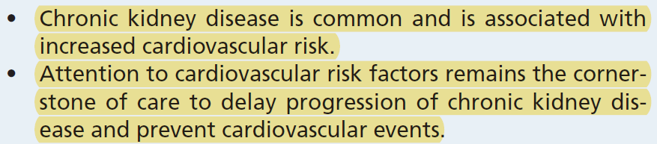
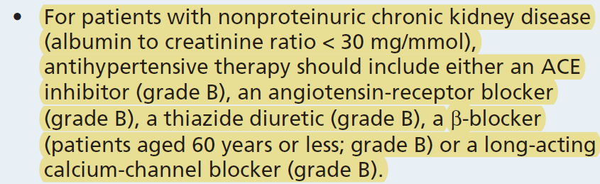
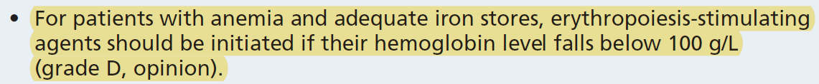
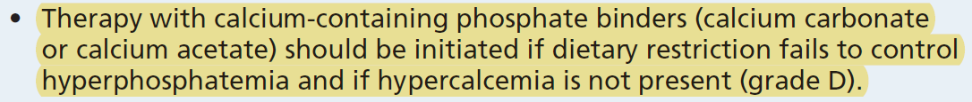
Clinical Guidelines: Highlighted Parts (CKD)
[1] p. 1154 🡪
[1] p. 1156 🡪
[1], p. 1159 🡪
[1], p. 1160 🡪
[2], p. e204 🡪

Slide 4
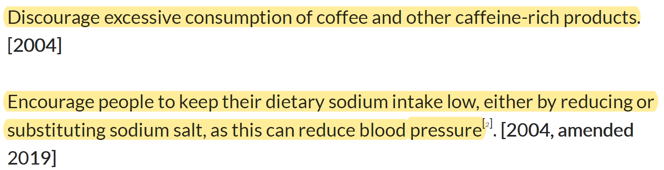
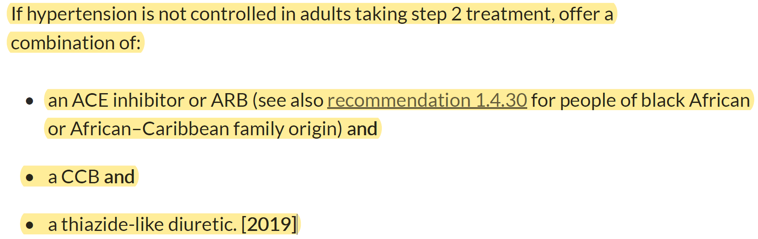
Clinical Guidelines: Highlighted Parts (HTN)
[3], p. 9 🡪
[3], p. 16 🡪

Slide 5
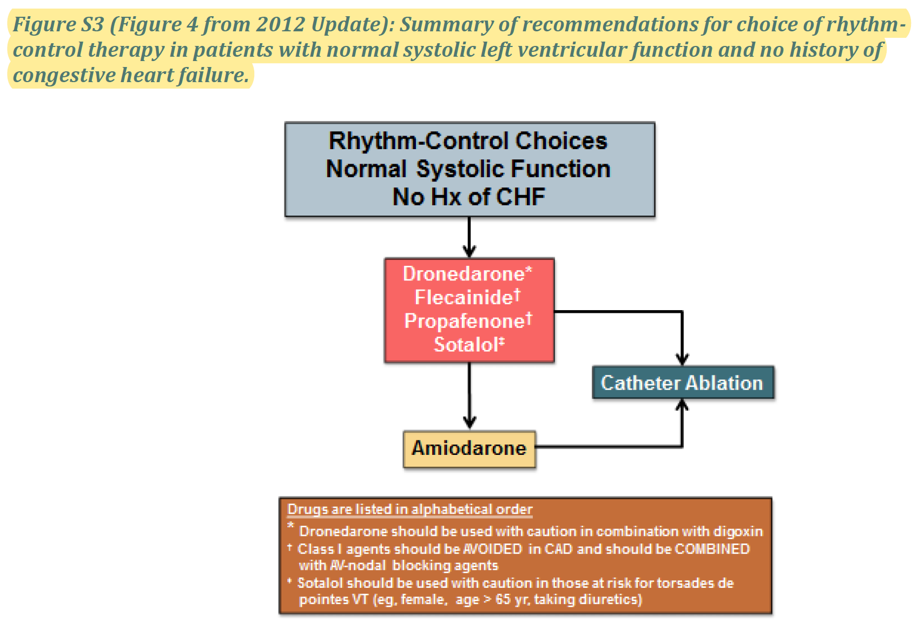
Clinical Guidelines: Highlighted Parts (AFib)
[4], p. 13 🡪
[4], p. 9 ↓

Slide 6
Domain Knowledge
Knowledge | Sources
In high-risk non-valvular AFib patients (CHA2DS2 ≥ 1) warfarin is favored over aspirin for stroke prevention. | Garg et al., 2010; p. 45, 46
Warfarin is anticoagulant | DrugBank
Amiodarone is counter-indicated for patient diagnosed with CKD and it is advised to prescribe propafenone instead. | Khouri et al., 2015; p. 64
Amiodarone is potassium channel blocker (PCB) | DrugBank
Propafenone is a sodium channel blocker (SCB) | DrugBank
Combining ACE inhibitor with most beta-blockers (BB) is not recommended. Moreover, the combination of higher-dose diltiazem and beta-blockers is also not advised. | Richard & Tobe, 2014. p. s43, s44
Diltiazem is a calcium channel blocker (CCB) | DrugBank
Organizational Knowledge
Knowledge
Considering that John is prescribed ACE inhibitors, his kidney function needs to be tested within the next 3 months for possible deterioration. It is also advised that while conducting the blood test, at the same time the patient has the ECG test to assess efficacy of prescribed treatment for AFib.

Slide 7
Mitigation of Adverse Interactions
Adverse interactions
Due to AFib, CVD prevention needs to be more aggressive (low-dose aspirin should be replaced by warfarin)
Potassium channel blocker (PCB, e.g., amiodarone), is contraindicated for patients with CKD
Combining beta-blocker (BB) with ACEI or CCB is not recommended
Suggested treatment
Replace low-dose aspirin with anticoagulant (warfarin)
Replace PCB (amiodarone) with sodium channel blocker (SCB)
Do not prescribe BB
Patient preferences
Replace warfarin with DOAC (e.g., apixaban) to avoid regular checking the INR level

Slide 8
Features for Decision Support
 | Type of interaction
A1 | Drug from a CPG has an effect on a comorbid condition (including ADE) | Amiodarone is contraindicated for CKD due to possible thyroid dysfunction and pulmonary toxicity
A2 | Two or more drugs from different CPGs may interact | BB is contraindicated with ACEI or CCB due to the risk of atrioventricular block and bradycardia, and a lack of antihypertensive efficacy
 | Types of mitigation
B4 | Replacing a drug with a safer / non-interacting drug / more effective drug for comorbidity | PCB (amiodarone) with SCB (propafenone)
B4 | Replacing a drug with a safer / non-interacting drug / more effective drug for comorbidity | Replace low-dose aspirin with warfarin
B5 | Discard unsafe/interacting drug | Discard BB to avoid interactions with ACEI or CCB
 | Other features
C1 | Patient preferences and/or patient burden | Replace warfarin with DOAC to avoid regular INR tests
C2 | Optimization of clinical resources | Blood test and ECG test should be done at the same time

